Slide 1
Image to Image translation using GANs
Team members:
Monica Dommaraju
Swati Narkhede
Sri Sruthi Chilukuri

Slide 2
Abstract
Image to image translation is an application of computer vision techniques where the goal is to learn mapping between a given input image and output.
GAN’s have an ability to create multiple plausible outputs and hence have wider range of applications.
Applications include: Style transfer, object transfiguration, season transfer and photo enhancement, black and white images, etc.

Slide 3
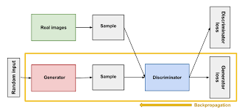
Introduction
To carry out this image translation task, we have used a Pix2Pix GAN network. This is an CNN approach taken to work with large images.
Pix2Pix uses a conditional GAN or cGAN that generates the output image is conditional on an input i.e. the source image.
The architecture has a discriminator-generator setup. Both are trained in a “zero-sum game” fashion.
Another approach taken to perform translation was by using “CycleGAN”.

Slide 4
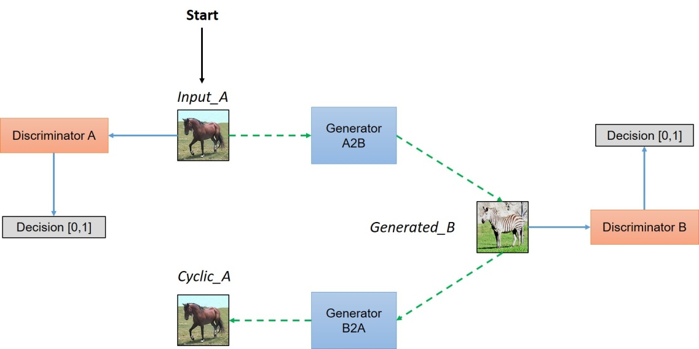
Introduction(Contd..)
The architecture composition of the cycleGAN is as follows:
The model architecture is comprised of two generator models: one generator (Generator-A) for generating images for the first domain (Domain-A) and the second generator (Generator-B) for generating images for the second domain (Domain-B).
Generator-A -> Domain-A
Generator-B -> Domain-B

Slide 5
Related Work
This work is based on a research paper ‘Image-to-Image Translation with Conditional Adversarial Networks’ by researchers from UC Berkeley.
They have performed Image to Image translation for various problems such as Semantic labels to photo, Black and White to color photos, sketch to photos, day and night, etc.
Implementation was done using PyTorch.
Researchers trained the map to aerial image model on 200 epochs.

Slide 6
About the dataset
The dataset is prepared for training a Pix2Pix GAN model in keras.
One of the datasets that was provided on Pix2Pix website: Maps dataset was used.
Contains satellite images of NewYork along with corresponding google maps images of the same region.
Train:Validation ratio is 1097:1099

Slide 7
Methodology
Architecture is comprised of two models: the discriminator and the generator.
The discriminator is a CNN that performs conditional image classification.
The generator is an encoder-decoder model using a U-Net architecture. The model takes a source image (e.g. satellite photo) and generates a target image (e.g. Google maps image)
Then, there is a GAN function that takes the already defined generator and discriminator models as arguments and connects both of them using the Keras functional API.

Slide 8
Code Walkthrough..

Slide 9
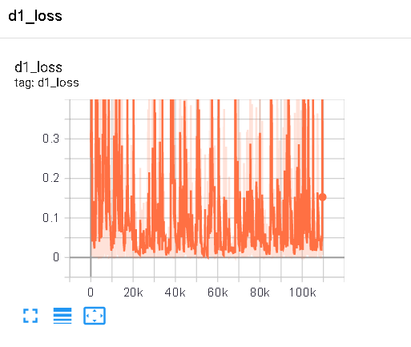
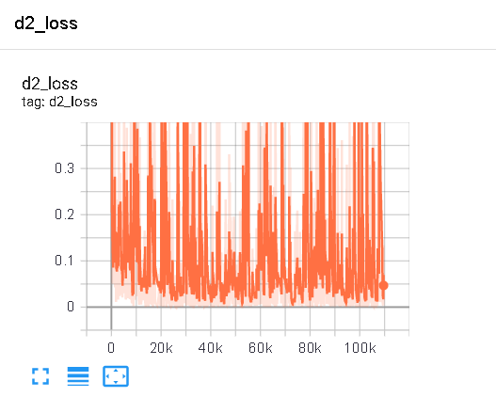
Tensorboard Setup to Visualize loss

Slide 10
Experiments
We have performed few experiments with hyperparameter tuning.
Exp No. | No. of Epochs | Learning Rate | Generator Loss | Discriminator Loss | Composite Loss
1 | 100 | 0.0002 | 0.002 | 0.009 | 8.06
2 | 100 | 0.001 | 0.02 | 0.013 | 13.512
3 | 150 | 0.0002 | 0.0002 | 0.070 | 11.024

Slide 11
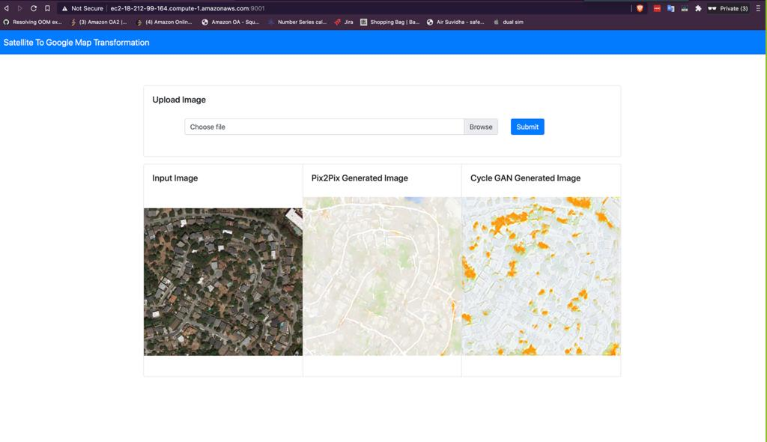
Deployment of the model

Slide 12
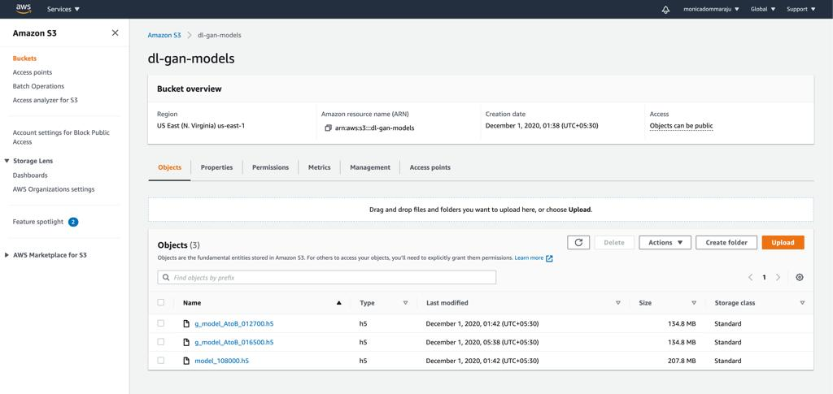
Amazon S3

Slide 13
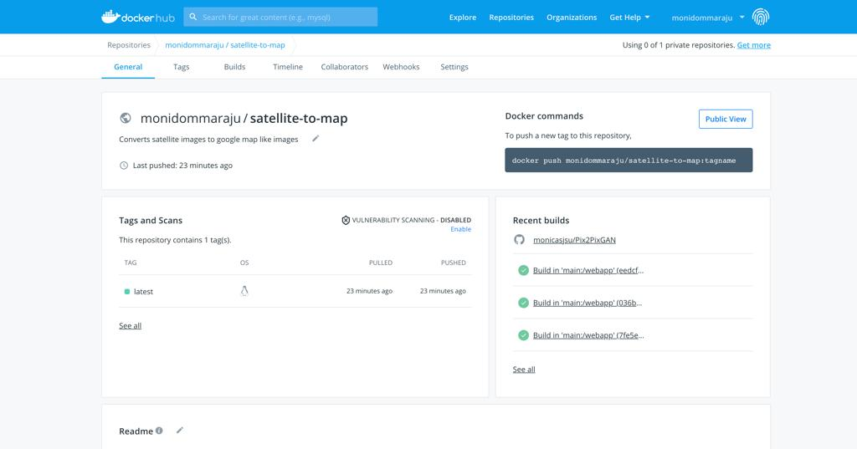
DockerHub

Slide 14
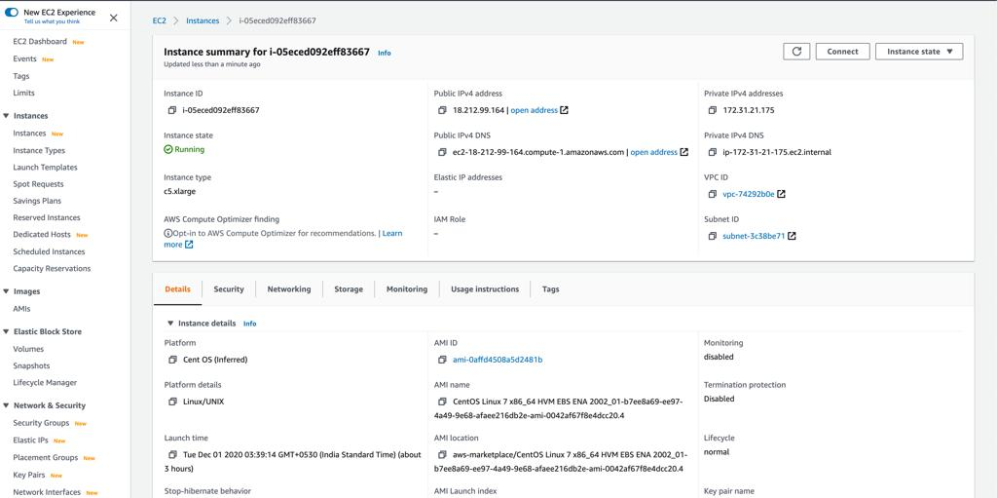
AWS EC2 Instance

Slide 15
Project Contribution
Tasks | Task Assignee
Literature Survey | Sruthi, Monica, Swati
Project Proposal | Sruthi
Data Collection | Swati
Data Preparation | Monica
Pix2Pix GAN Model Training | Swati, Monica
Hyperparameter Tuning | Swati
Pix2Pix GAN Model Evaluation | Swati, Sruthi
CycleGAN Model Training | Sruthi
CycleGAN Model Evaluation | Sruthi
User Interface | Monica
Utility Methods | Monica
Deployment Pipeline | Monica

Slide 16
Conclusion
Both the cycleGAN and Pix2Pix GAN methodologies have been explored to perform image to image translations.
As an end result it was understood that the cycleGAN is computationally more expensive than generic GAN networks.
The advantage of cycle GAN’s is that the images can be inter-converted (A <-> B).
More training time with increased dataset size can possibly generate more accurate results.

Slide 17
Thank You!

